Slide 1
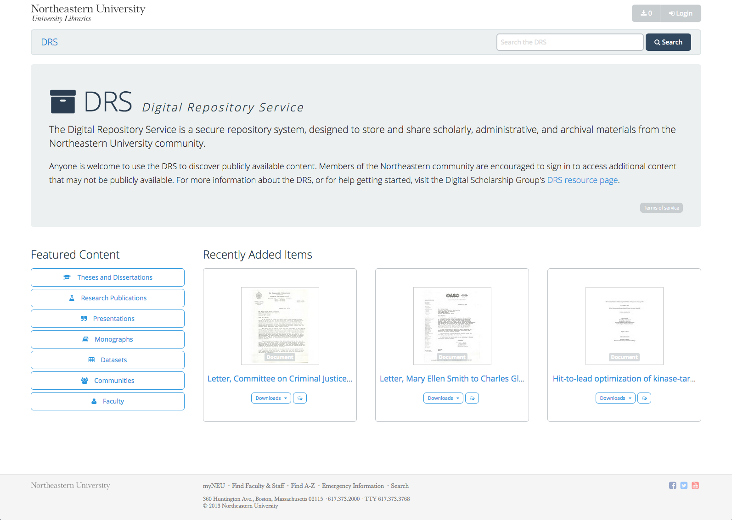

Sarah Sweeney
Digital Repository Manager
Northeastern University Libraries
repository.library.northeastern.edu
Notes:
Promotional Slide

Slide 3
DRS
Resources
Contact
https://repository.library.northeastern.edu
http://dsg.neu.edu/resources/drs
sj.sweeney@neu.edu
Sarah Sweeney
Digital Repository Manager
Northeastern University Libraries
repository.library.northeastern.edu
Notes:
Promotional Slide

